Slide 1

Modeling Diabetic Patient Mortality
Ian Wittler

Slide 2
Introduction
What is Diabetes Mellitus?
Objectives
Data Exploration

Slide 3
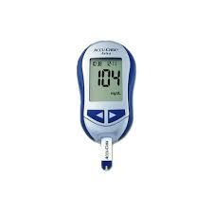
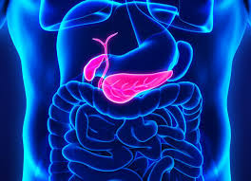
About Diabetes Mellitus
A disease which results in the complications producing insulin
100 million plus U.S. adults live with diabetes or prediabetes
There are 3 main classifications:
Type 1
Type 2
Gestational

Slide 4
Goals and Objectives
1. Determine how care management of diabetic patients effects patient outcome.
2. Develop a model that targets diabetic patients and utilizes glucose measurements to predict patient outcome.

Slide 5
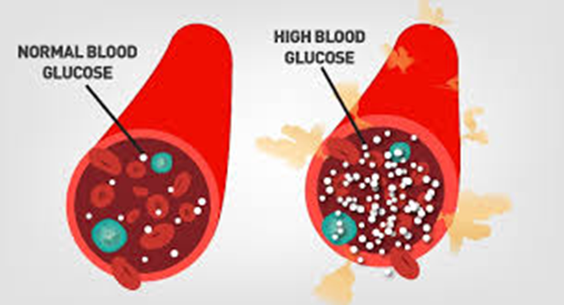
Data Exploration and Visualization
Source
Query
Visualize

Slide 6
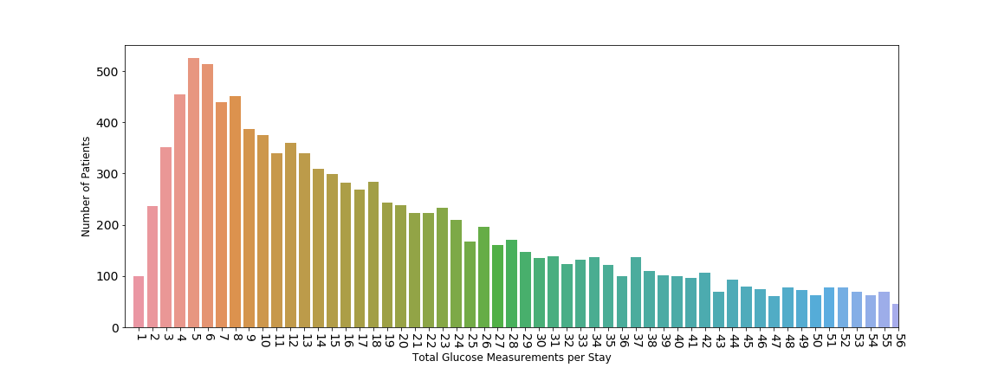
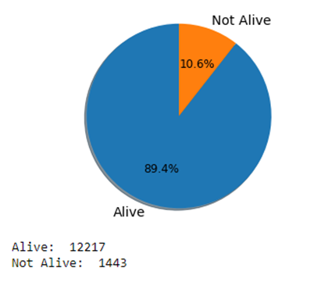
Glucose Measurement Distribution
Outcome Distribution

